Slide 1
Image-Based Deep Learning
경상대학교 정보통신공학과
이윤환, 김동휘, 김지연, 김진현, 이웅섭
2020.04.10

Slide 2
목차
Image Class
CNN Model review
CNN Result
Transfer Learning review
Transfer Learning result

Slide 3
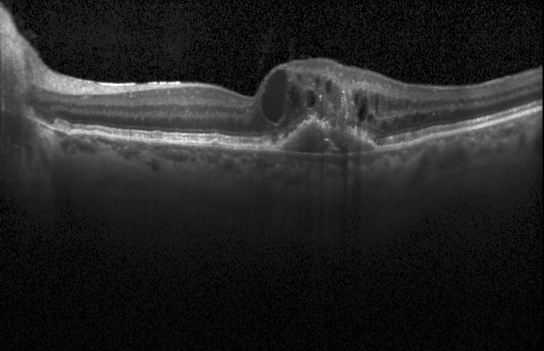
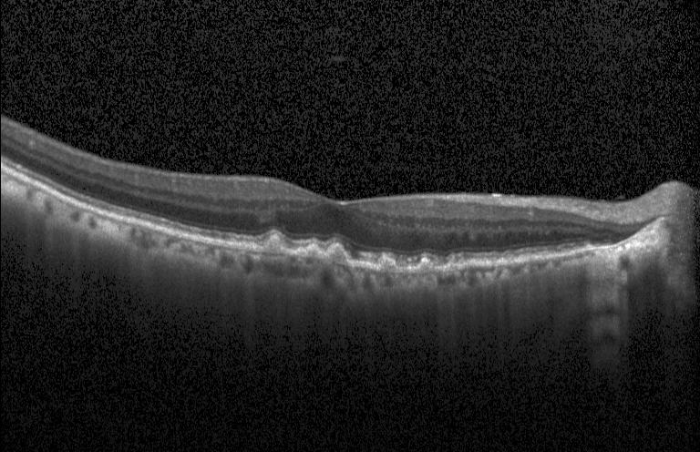
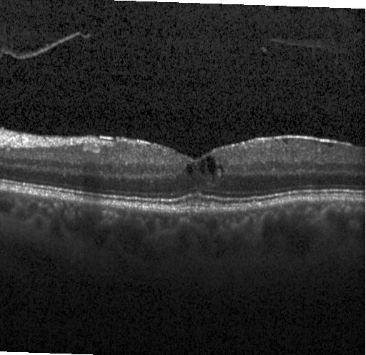
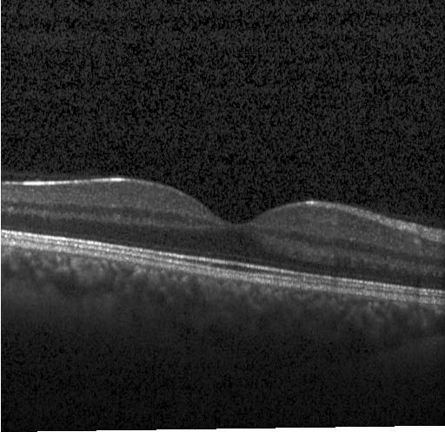
Image Class
CNV
DRUSEN
DME
NORMAL

Slide 4
CNN model
데이터가 0~1사이의 값을 가지도록 정규화
dropout(0.25)
conv과 fully conected 다음 배치정규화를 추가
모델 layers

Slide 5
 | case1 |  | case2 |  | case3 |  | case4 |  | case5
Training data | 30600 (각 7650) |  |  |  |  |  |  |  | 76484
Test data | 3400 (각 850) |  |  |  |  |  |  |  | 8000 (각 2000)
Batch size | 64
Preprocessing | 299x299x3
Normalization | 0~1
Epochs | 30 |  |  |  |  |  |  |  | 50
Batch normalization | True |  | True |  | False |  | False |  | True
Dropout | False |  | True(0.25) |  | False |  | True(0.25) |  | True(0.25)
ACC
Test Accuracy | 0.6214 |  | 0.6512 |  | 0.5661 |  | 0.5326 |  | 0.6919
CNV | 0.4764 | CNV : 405 DME : 292 Drusen : 137 Normal : 16 | 0.5894 | CNV : 501 DME : 248 Drusen : 94 Normal : 7 | 0.3705 | CNV : 315 DME : 338 Drusen : 173 Normal : 24 | 0.3141 | CNV : 267 DME : 373 Drusen : 185 Normal : 25 | 0.84 | CNV : 1680 DME : 263 Drusen : 7 Normal : 50
DME | 0.7035 | CNV : 28 DME : 598 Drusen : 85 Normal : 139 | 0.6741 | CNV : 22 DME : 573 Drusen : 68 Normal : 187 | 0.6576 | CNV : 23 DME : 559 Drusen : 86 Normal : 182 | 0.5941 | CNV : 20 DME : 505 Drusen : 38 Normal : 287 | 0.7475 | CNV : 93 DME : 1495 Drusen : 6 Normal : 406
DRUSEN | 0.547 | CNV : 42 DME : 183 Drusen : 465 Normal : 160 | 0.4517 | CNV : 38 DME : 153 Drusen : 384 Normal : 275 | 0.4376 | CNV : 37 DME : 168 Drusen : 372 Normal : 273 | 0.3258 | CNV : 13 DME : 177 Drusen : 277 Normal : 383 | 0.2075 | CNV : 375 DME : 292 Drusen : 415 Normal : 918
NORMAL | 0.7588 | CNV : 1 DME : 135 Drusen : 69 Normal : 645 | 0.8894 | CNV : 2 DME : 68 Drusen : 24 Normal : 756 | 0.7988 | CNV : 1 DME : 120 Drusen : 50 Normal : 679 | 0.8964 | CNV : 0 DME : 64 Drusen : 24 Normal : 762 | 0.9725 | CNV : 4 DME : 44 Drusen : 7 Normal : 1945
* Case5 dataset *
CNV : 35,455 DME : 9,598 DRUSEN : 6,866 NORMAL :24,565

Slide 6
 | case1 |  | case2 |  | case3 |  | case4
Training data | 30600 (각 7650)
Test data | 3400 (각 850)
Batch size | 64
Preprocessing | 299x299x3
Normalization | 0~1
Epochs | 30
Batch normalization | True
Dropout | True(0.25)
acc
Test Accuracy | 0.5823 |  | 0.6167 |  | 0.6008 |  | 0.6623
CNV | 0.4 | CNV : 340 DME : 410 Drusen : 77 Normal :23 | 0.5929 | CNV : 504 DME : 293 Drusen : 53 Normal : 0 | 0.5623 | CNV : 478 DME : 331 Drusen : 40 Normal : 1 | 0.5647 | CNV : 480 DME : 225 Drusen : 126 Normal : 19
DME | 0.6894 | CNV : 12 DME : 586 Drusen : 29 Normal : 223 | 0.8694 | CNV : 35 DME : 739 Drusen : 21 Normal : 55 | 0.8752 | CNV : 23 DME : 744 Drusen : 21 Normal : 62 | 0.7505 | CNV : 55 DME : 638 Drusen : 54 Normal : 103
DRUSEN | 0.3423 | CNV : 36 DME : 198 Drusen : 291 Normal : 325 | 0.3341 | CNV : 81 DME : 384 Drusen : 284 Normal : 101 | 0.24 | CNV : 22 DME : 435 Drusen : 204 Normal : 189 | 0.4647 | CNV : 57 DME : 226 Drusen : 395 Normal : 172
NORMAL | 0.8976 | CNV : 0 DME : 72 Drusen : 15 Normal : 763 | 0.6705 | CNV : 3 DME : 242 Drusen : 35 Normal : 570 | 0.7258 | CNV : 2 DME : 208 Drusen : 23 Normal : 617 | 0.8694 | CNV : 4 DME : 66 Drusen : 41 Normal : 739

Slide 7
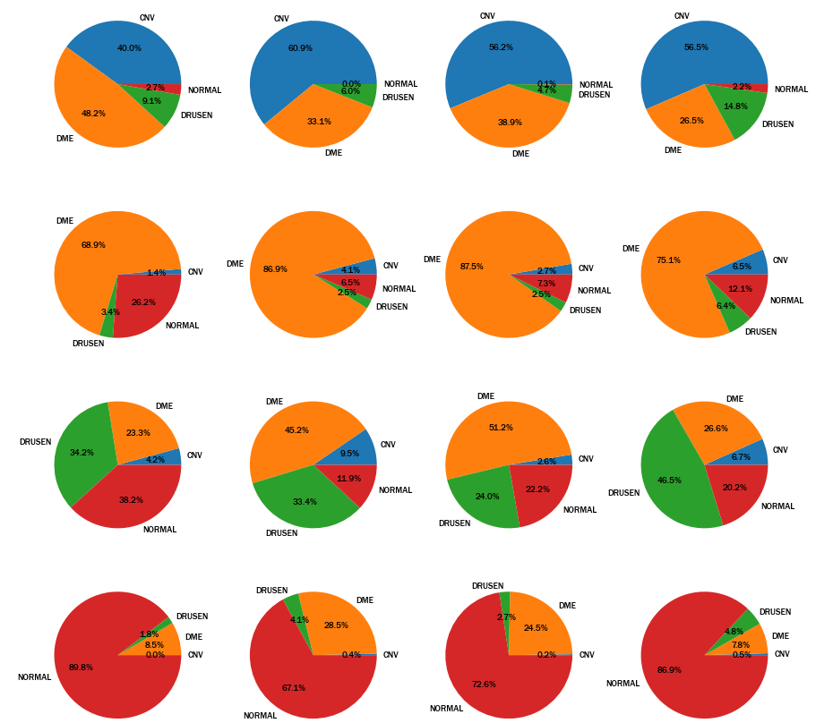
Case1
Case2
Case3
Case4
*Training set : 30,600
*Test set : 3,400
CNV
DME
DRUSEN
NORMAL

Slide 8
 | case1 |  | case2 |  | case3 |  | case4
Training data | 76484 (CNV : 35,455, DME : 9,598, DRUSEN : 6,866, NORMAL : 24,565)
Test data | 8000 (각 2000)
Batch size | 64
Preprocessing | 299x299x3
Normalization | 0~1
Epochs | 30
Batch normalization | True
Dropout | True(0.25)
acc
Test Accuracy | 0.646 |  | 0.7045 |  | 0.6084 |  | 0.6224
CNV | 0.8525 | CNV : 1705 DME : 229 Drusen : 2 Normal : 64 | 0.926 | CNV : 1852 DME : 96 Drusen : 37 Normal : 15 | 0.6075 | CNV : 1215 DME : 577 Drusen : 56 Normal : 152 | 0.862 | CNV : 1724 DME : 188 Drusen : 18 Normal : 70
DME | 0.6945 | CNV : 180 DME : 1389 Drusen : 1 Normal : 430 | 0.6345 | CNV : 322 DME : 1269 Drusen : 18 Normal : 391 | 0.7465 | CNV : 89 DME : 1493 Drusen : 8 Normal : 410 | 0.607 | CNV : 176 DME : 1214 Drusen : 2 Normal : 608
DRUSEN | 0.067 | CNV : 631 DME : 247 Drusen : 134 Normal : 988 | 0.2895 | CNV : 504 DME : 129 Drusen : 579 Normal : 788 | 0.116 | CNV : 425 DME : 528 Drusen : 232 Normal : 815 | 0.052 | CNV : 984 DME : 227 Drusen : 104 Normal : 685
NORMAL | 0.97 | CNV : 7 DME : 53 Drusen : 0 Normal : 1940 | 0.968 | CNV : 9 DME : 39 Drusen : 16 Normal : 1936 | 0.9635 | CNV : 5 DME : 65 Drusen : 3 Normal : 1927 | 0.9685 | CNV : 7 DME : 49 Drusen : 7 Normal : 1937

Slide 9
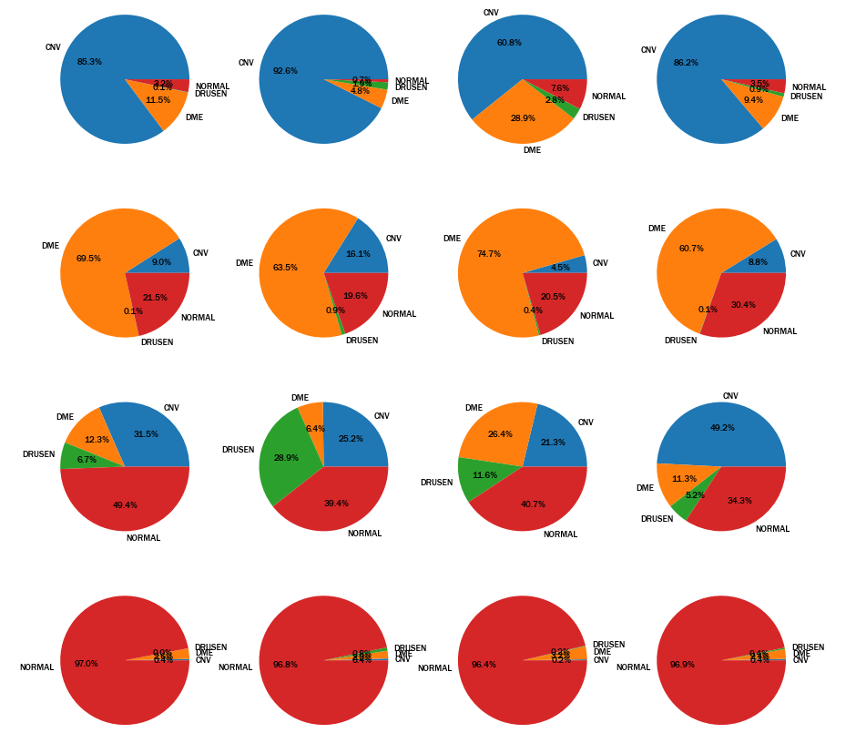
Case1
Case2
Case3
Case4
*Training set : 76,484
*Test set : 8,000
CNV
DME
DRUSEN
NORMAL

Slide 10

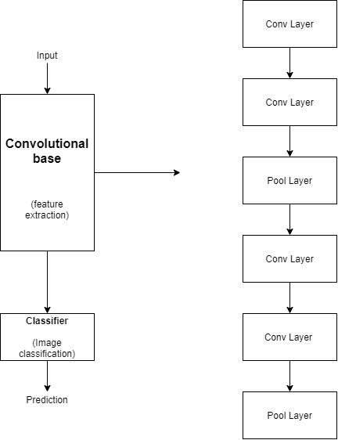
Transfer Learning

Slide 11
Transfer Learning
사전 학습 모델 선택
데이터크기-유사성 그래프에서 어떤 부분에 속하는지 확인
Fine-tune 하기
4. Classifier (분류기) 선택

Slide 12
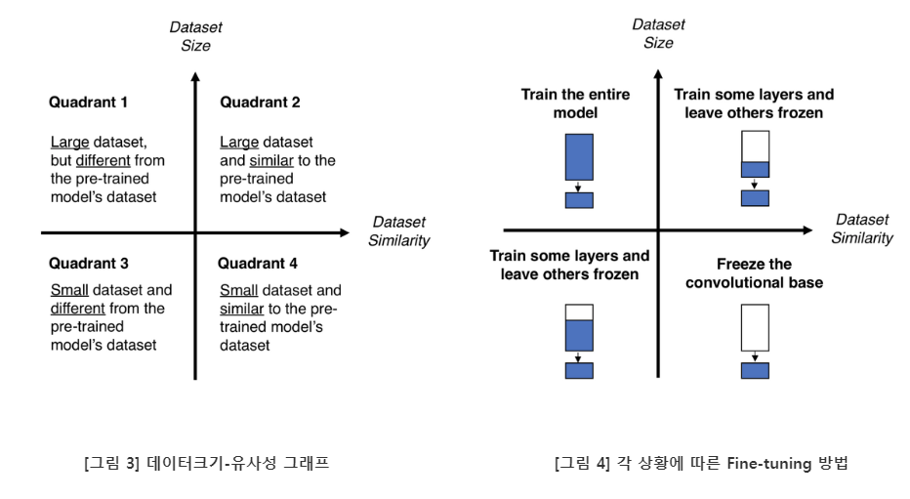
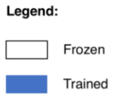
Fine-Tuning

Slide 13
Model 비교
모델 | 사이즈 | 정확도 | 매개변수(parameter) | 깊이
InceptionResNetV2 | 215MB | 0.953 | 55,873,736 | 572
Xception | 88MB | 0.945 | 22,910,480 | 126
InceptionV3 | 92MB | 0.937 | 23,851,784 | 159
DenseNet121 | 33MB | 0.923 | 8,062,504 | 121
ResNet50 | 98MB | 0.921 | 25,636,712 | 50
VGG16 | 528MB | 0.901 | 138,357,544 | 23

Slide 14
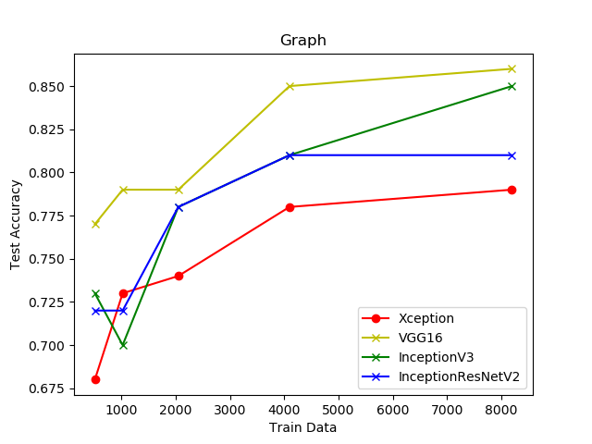
Model Check
 | Train Data
 | 512 | 1024 | 2048 | 4096 | 8192
Xception | 0.68 | 0.73 | 0.74 | 0.78 | 0.79 | Test Accuracy
VGG16 | 0.77 | 0.79 | 0.79 | 0.85 | 0.86
InceptionV3 | 0.73 | 0.70 | 0.78 | 0.81 | 0.85
Inception ResNetV2 | 0.72 | 0.72 | 0.78 | 0.81 | 0.81

Slide 15
Data1
 | Train (비율) | Test
Total76484 8000 | 83484 (100%) | 1000
CNV | 37205 (43.61%) | 250
DME | 11349 (13.32%) | 250
DRUSEN | 8617 (10.33%) | 250
NORMAL | 27313 (32.74%) | 250
Image_size | 224 * 224 * 3
Epochs | 100
Normalization | 0 ~ 1

Slide 16
Case 1
 | Test1 | Test2 | Test3 | Test4 | Test5 | Test6 | Test7 | Test8 | Test9
모델 | VGG16
Train data | 512 | 1024 | 2048 | 4096 | 8192 | 16384 | 42496 | 64000 | 83200
Test data | 1000
model(Acc) | 1 | 0.99 | 0.968 | 0.967 | 0.936 | 0.967 | 0.959 | 0.970 | 0.975
test (Acc) | 0.828 | 0.83 | 0.878 | 0.869 | 0.907 | 0.93 | 0.951 | 0.957 | 0.968
CNV | 0.979 | 0.98 | 0.977 | 0.97 | 0.987 | 0.996 | 1 | 1 | 0.98
DME | 0.623 | 0.703 | 0.62 | 0.799 | 0.829 | 0.946 | 0.888 | 0.888 | 0.934
DRUSEN | 0.92 | 0.934 | 0.93 | 0.926 | 0.98 | 0.97 | 0.995 | 0.995 | 1
NORMAL | 0.802 | 0.893 | 0.949 | 0.932 | 0.92 | 0.894 | 0.947 | 0.947 | 0.958

Slide 17
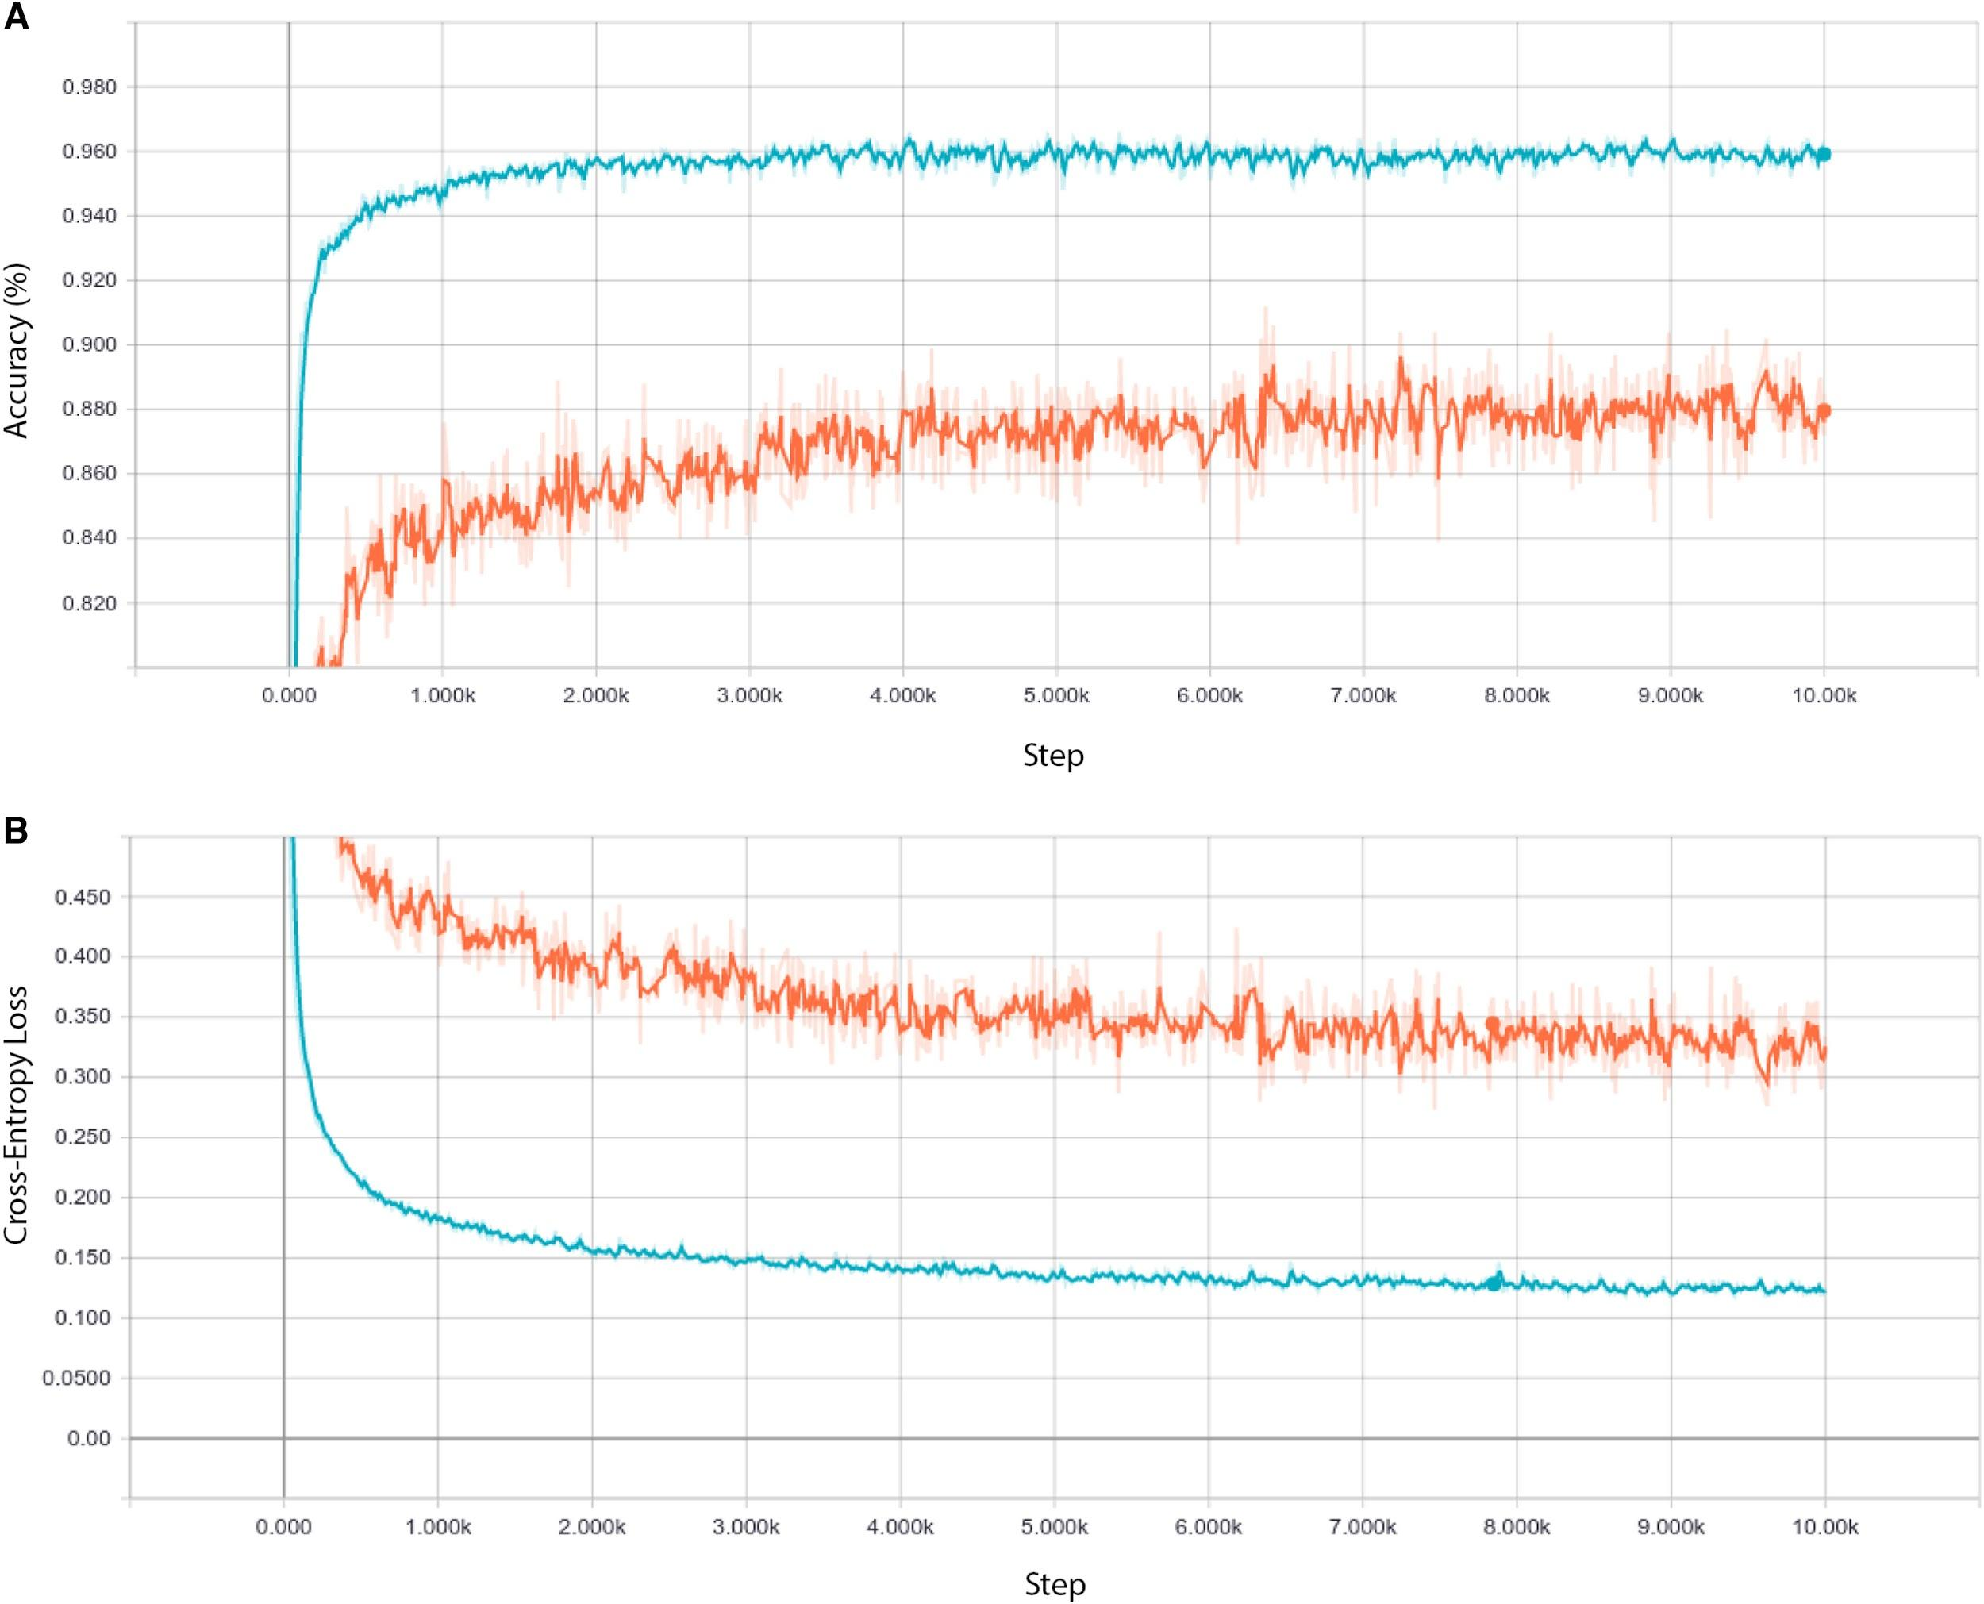
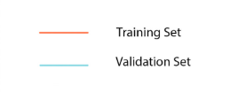
Original Result
96%
88%
100000
100000

Slide 18
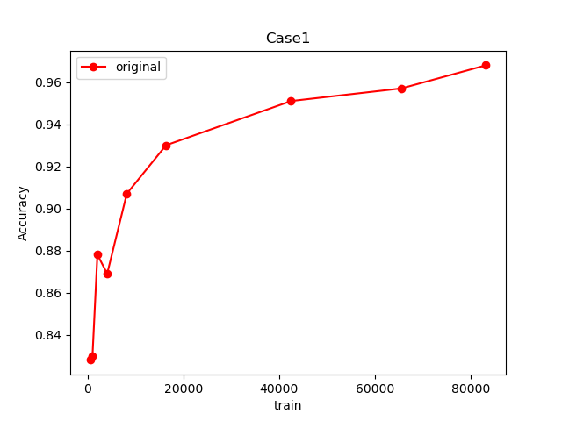
Case1 (Graph)
0.951
0.968
0.957
0.93
0.907
Test Acc
0.878
0.869
0.83

Slide 19
Data2
 | Train | Test
Total | 30600 | 3400
CNV | 7650 | 850
DME
DRUSEN
NORMAL
Image_size | 224*224*3
Epochs | 100
Normalization | 0 ~ 1

Slide 20
Case2
 | Case1 | Case2 | Case3 | Case4 | Case5 | Case6 | Case7
모델 | VGG16
Train data | 512 | 1024 | 2048 | 4096 | 8192 | 16384 | 30592
Test data | 3400
model (Acc) | 0.982 | 0.992 | 0.985 | 0.967 | 0.954 | 0.95 | 0.945
test (Acc) | 0.739 | 0.784 | 0.788 | 0.8155 | 0.825 | 0.849 | 0.844
CNV | 0.813 | 0.836 | 0.868 | 0.912 | 0.890 | 0.906 | 0.906
DME | 0.727 | 0.794 | 0.800 | 0.78 | 0.767 | 0.860 | 0.842
DRUSEN | 0.706 | 0.755 | 0.743 | 0.770 | 0.780 | 0.807 | 0.812
NORMAL | 0.716 | 0.749 | 0.770 | 0.834 | 0.838 | 0.838 | 0.816

Slide 21
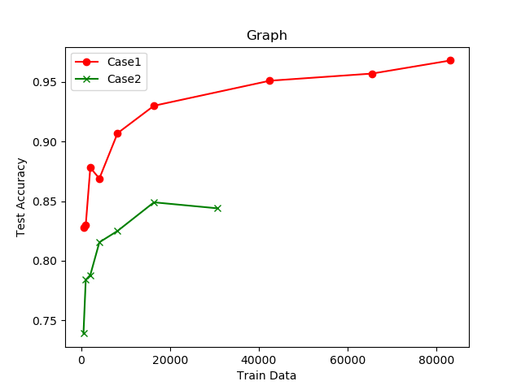
Graph
0.951
0.968
0.957
0.907
0.93
0.878
0.869
0.849
0.83
0.844
0.815
0.825
0.788
0.784
0.739

Slide 22
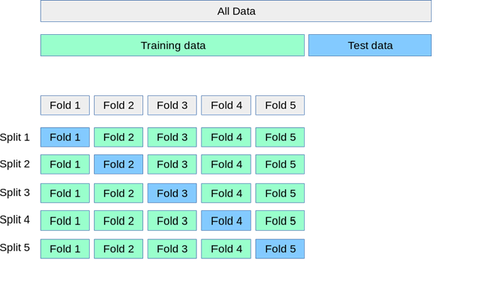
K-Fold (교차검증)

Slide 23
Data3 (10 Fold)
 | Train | Test
Total | 30600 | 3400
CNV | 7650 | 850
DME
DRUSEN
NORMAL
Image_size | 299 * 299 * 3
Epochs | 100
Normalization | 0~1

Slide 24
Case3
 | 1 Fold | 2 Fold | 3 Fold | 4 Fold | 5 Fold | 6 Fold | 7 Fold | 8 Fold | 9 Fold | 10 Fold
모델 | Inception V3
Traindata | 30592
Test data | 3400
model(A) | 0.97 | 0.957 | 0.9761 | 0.874 | 0.9641 | 0.9060 | 0.9178 | 0.956 | 0.9331 | 0.9206
test | 0.852 | 0.845 | 0.8722 | 0.809 | 0.861 | 0.852 | 0.8408 | 0.880 | 0.8476 | 0.8429
CNV | 0.884 | 0.908 | 0.9281 | 0.838 | 0.847 | 0.860 | 0.8301 | 0.910 | 0.7606 | 0.8416
DME | 0.871 | 0.871 | 0.8832 | 0.916 | 0.880 | 0.883 | 0.8756 | 0.900 | 0.9623 | 0.8512
DRUSEN | 0.771 | 0.792 | 0.8094 | 0.719 | 0.843 | 0.811 | 0.8264 | 0.774 | 0.8127 | 0.8686
NORMAL | 881 | 0.806 | 0.8680 | 0.765 | 0.875 | 0.813 | 0.831 | 0.936 | 0.8550 | 0.8102

Slide 25
Case Check
 | Case3
모델 | InceptionV3
Train Data | 30592
Test Data | 3400
model(A) | 0.9374
test | 0.8502
CNV | 0.8607
DME | 0.8893
DRUSEN | 0.8027
NORMAL | 0.8440

Slide 26
 | Case1 | Case2 | Case3
모델 | VGG16 | VGG16 | InceptionV3
Train Data | 42496 | 30592
Test Data | 1000 | 3400
model(A) | 0.959 | 0.945 | 0.9374
test | 0.951 | 0.844 | 0.8502
CNV | 1 | 0.906 | 0.8607
DME | 0.888 | 0.842 | 0.8893
DRUSEN | 0.995 | 0.812 | 0.8027
NORMAL | 0.947 | 0.816 | 0.8440

Slide 29
